Slide 1
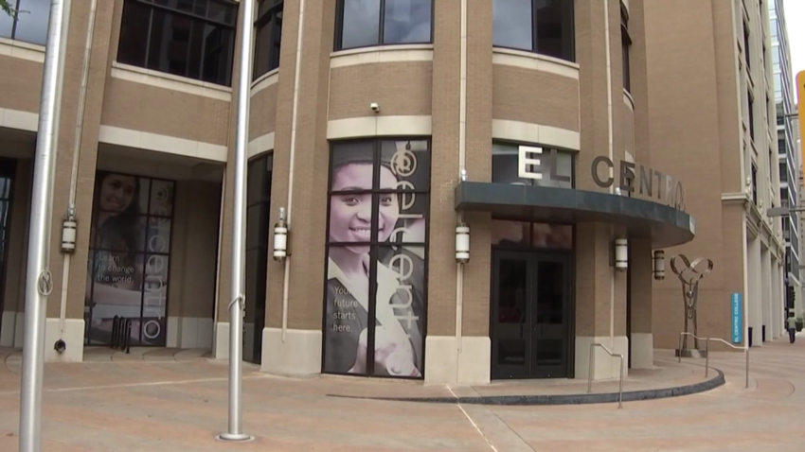
Diagnostic Medical Sonography (DMS) Information Session
Notes:
Welcome to the orientation session for the Dallas College Diagnostic Medical Sonography Program. In this session we will review information about the sonography profession. We will provide an overview of the program structure. We will discuss the program time and financial commitment. Then we will cover the steps necessary to apply to the program. Viewing this session will take approximately 20 minutes. Take your time to listen to the audio and read each slide. Forward each slide when you are ready.

Slide 2
Viewing instructions
Step 1: Students are required to view all the information on the college website. Dallas College Sonography Program
Step 2: Download, read and save the Diagnostic Sonography information packet now, before you continue. Health programs information packets
Step 3: View the Information Session (as often as you like). You are free to pause if you need to, but you must watch the video in its entirety in order to be added to the DMS Applicant Organization in eCampus.
Notes:
Information is available on the Dallas College website about the sonography program. Students should download and read the Sonography Information Packet. In order to receive the program application, you must watch this entire information session.

Slide 3
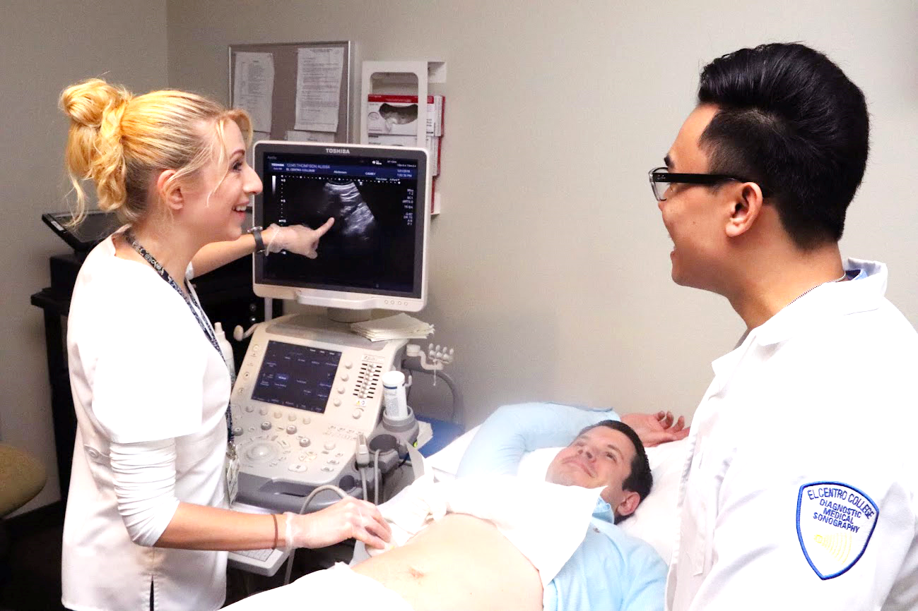
Program Outcomes & Accreditation
The Dallas College Sonography program, established in 1984, was the first in Texas. The Sonography Program has high retention, graduation, employment and registry passage rates. (info at: Program Outcomes)
The Program received a 10-year accreditation renewal from
the Commission on Accreditation of Allied Health Education
Programs CAAHEP (Joint Review Committee on Education) in 2022.
Notes:
The Sonography program was established in 1984 on the El Centro campus and is the oldest sonography Program in North Texas. The program is assessed for quality based on program outcomes. You will notice there is a link to our program outcomes. Feel free to pause the information session and follow any of the provided links as they offer valuable information. The Sonography Program which is sponsored by Dallas College is accredited by CAAHEP upon the recommendation of the JRCDMS. The program recently received a 10 year accreditation renewal.

Slide 4
Program Overview
Associates Degree Program = 65 Credit hours.
5 sequential semesters (not including prerequisites)
Degree plan can be found here, Sonography Degree Plans
Advanced Technical certificate available.
Applications are due Dec 31st.
A new cohort begins the program each June.
Instruction: includes classroom, lab and clinical practicum (practicums are held at local hospitals and clinics).
Time commitment: 4-5 days per week, expect 8 hours days (8-4:30). Occasionally practicums may be up to 12 hours and include nights or weekends (plus study time).
Classes are held in the Paramount Building of the El Centro Campus.
Notes:
The sonography program offers a 65 credit hour associates degree in applied science. Applicants who already possess a degree in direct healthcare may qualify for the advanced technical certificate. Applications to the program are submitted in the fall. A new cohort of students begins each June. The program requires a significant time commitment. A typical weekly schedule will include 3 days of clinical practicum. Two full days of classroom and lab instruction take place on the El Centro campus.

Slide 5
Financial Impact
Students find it difficult to work more than a few hours a week while in the program.
it is imperative that applicants prepare a budget and save money to help lessen the financial strain.
The college offers several resources that can be found on the Dallas College Financial Aid website.
Notes:
The sonography program requires extensive hours of study and practice to become a proficient sonographer. Students need to be aware of the financial impact of attending the sonography program. Students must plan ahead as it is difficult to work while in the program. Students may only miss one day per semester of clinical education. Therefore it is imperative that students have a plan in place for childcare, transportation and other responsibilities. Contact Dallas College financial aid for more information.

Slide 6
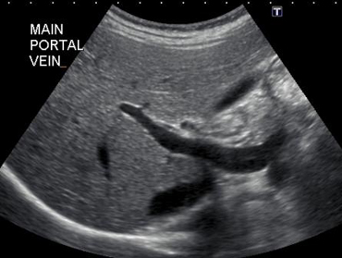
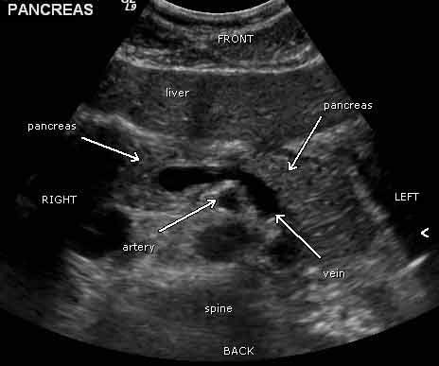
What is sonography?
Sonography uses ultrasound to produce diagnostic images of the anatomical structures of the body.
Ultrasound utilizes high frequency sound waves and does not use radiation.
Notes:
The sonography program prepares individuals to perform diagnostic examinations using high frequency sound waves to visualize soft tissue structures including the liver, gallbladder, kidneys, pregnant and non-pregnant uterus, and blood vessels as requested by the physician.

Slide 7
What is a sonographer?
A person who is highly trained to recognize normal anatomy and abnormal structures using ultrasound is a Diagnostic Medical Sonographer (RDMS).
Specialized areas included in the Diagnostic Medical Sonography program: Abdomen Extended (AB), Obstetrics & Gynecology (OB), and Vascular sonography (VT).
American Registry of Diagnostic Medial Sonography (ARDMS)
Career information can be found here, Sonography Career
Notes:
Sonography is a technically challenging and personally rewarding occupation. Most sonographers report a high satisfaction with the profession. Graduates of the Sonography Program are eligible to sit for designated registry exams through the ARDMS to obtain their Registered Diagnostic Medical Sonographer credential in Abdominal (AB) and Obstetrics & Gynecology and Vascular Technology. Advanced registries in pediatrics, breast and other specialties may be available after graduation.

Slide 8
Responsibilities of the Sonographer
Sonographers perform diagnostic imaging exams (sonograms) on patients and are important members of the patient care team.
Sonographers are involved in direct patient care and work in hospitals, clinics, imaging centers, and can also be employed as application specialists or sales reps.
An excellent resource for more information on sonography & sonographers is the Society of Diagnostic Sonography (Membership & Resources sections) SDMS website
Notes:
Sonographers often work in Radiology Departments as part of the diagnostic imaging team. Sonographers are involved with direct patient care and will be exposed to patients with infectious diseases. Although sonography involves less blood and body fluids than some health care roles, be aware that sonographers are involved in many aspects of direct patient care. You are encouraged to explore our professional organization website, the SDMS, to learn more about sonography.

Slide 9
Some of the duties you would be expected to perform as a sonographer:
Adjusting and maintaining imaging equipment | Precisely following physician’s orders.
Ensure patient safety | Preparing patients for exams.
Positioning the patient and equipment | Working with radiologists.
Operating equipment and computer systems Evaluating images to ensure optimal quality | Maintaining detailed patient records Prepare preliminary findings report
Notes:
A sonographer’s tasks are many and varied. Sonographers use independent judgement in operating the equipment to obtain the optimal diagnostic images. Sonographers provide the physician with a summary of pertinent clinical information and exam findings. Sonographers scan patients in all settings from the newborn nursery to the intensive care unit.

Slide 10
Communication Expectations
Communicate effectively in written and verbal form by:
Speaking clearly and succinctly when:
Explaining treatment procedures
Describing patient conditions
Implementing healthcare techniques
Function safely under stressful conditions with the ability to:
Adapt to the ever-changing environment inherent in clinical situations involving patient care
Utilizing computer skills to:
Use a variety of software programs and the internet for research and course projects.
Notes:
Communication is one of the sonographers most important tools. Effective communication is necessary to establish a positive relationship with the patient. Effective communication can elicit patient cooperation and understanding of expectations. In healthcare, situations are ever evolving. The sonographer must be prepared to function under stressful situations. Digital communication in the classroom and clinical setting requires students to use a variety of software programs.

Slide 11
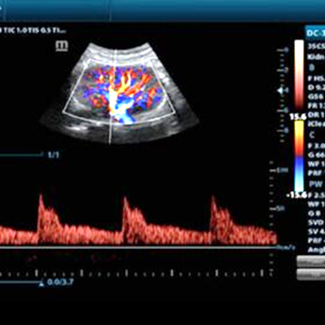
Physical Requirements
A career in Sonography includes:
the ability to lift and move patients and equipment
to move quickly during an emergency
to stand for long periods of time
to have good spacial and visual perception
listen for and hear Doppler sounds.
to see in low light situations while evaluating images
Notes:
The clinical experiences of the sonography program require that a student be physically fit and able to care for sick patients. This involves lifting, moving, and transferring patients. The student must be able to stand on his or her feet for 2-3 hour time periods and be able to reach across patients while scanning. Students are required to have good spatial and visual perception from a two-dimensional screen including the ability to visualize subtle grey-scale and color differences and the ability to hear subtle sound variations. Students will train in lab and clinical in low lighting conditions.

Slide 12
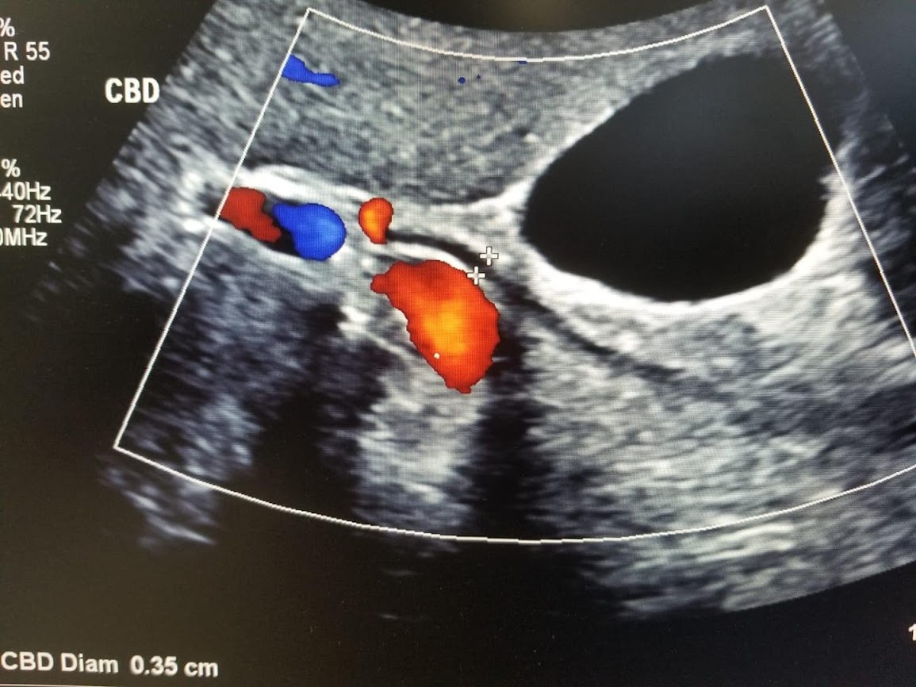
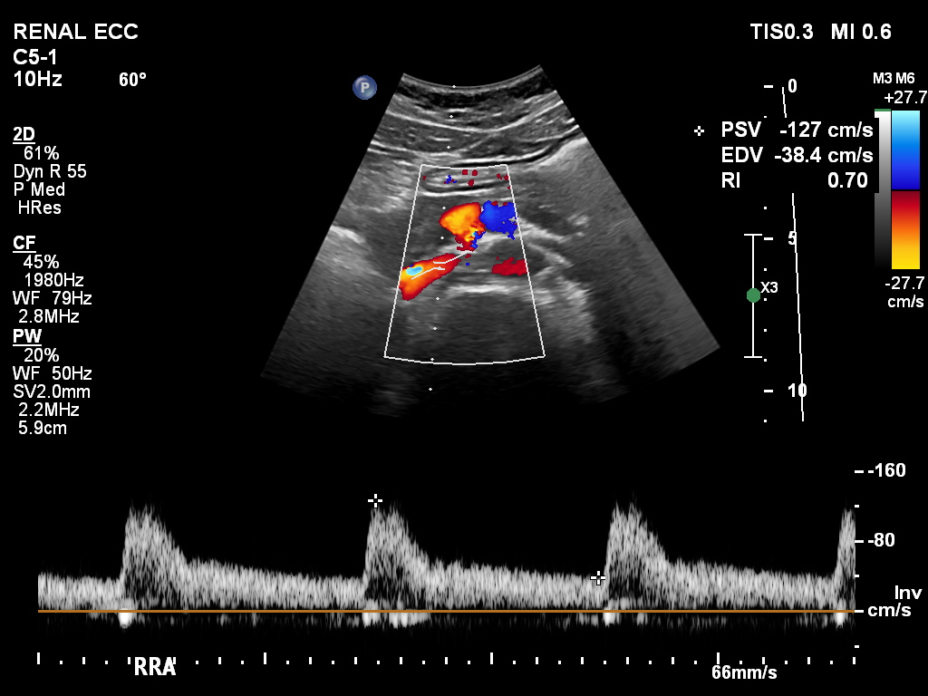
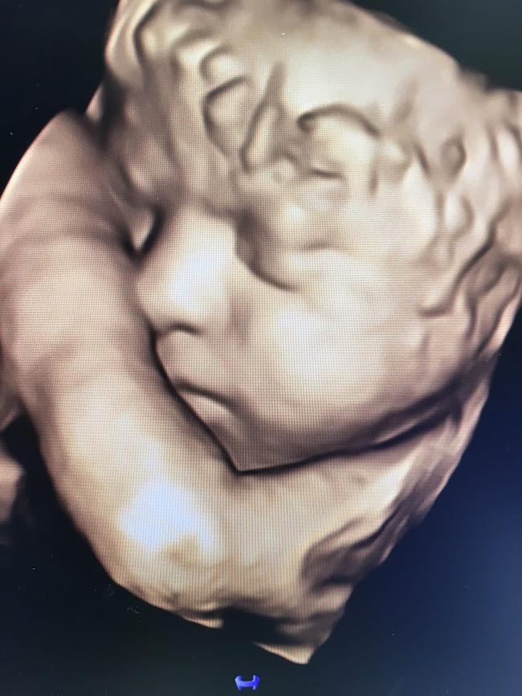
Career Outlook and Compensation
Bureau of Labor statistics 2022:
Mean salary is $78,210 Annual
$37.60 / hour per ‘US Bureau of Labor Statistics’
Forecast for job growth is 14% higher than other professions.
Notes:
Sonographers enjoy a positive job growth forecast. The Bureau of Labor Statistics is another great source of information on the profession.

Slide 13
The Application Process
Program Acceptance
Upload Supporting Documents
Complete Sonography Program Application
Complete Prerequisite Courses
Apply to Dallas College, work with Success Coach
Notes:
Now that you have some background on the program and the career lets talk about the application process. Step 1 is to apply to Dallas College. It is important to submit transcripts from all previous institutions even if you aren’t transferring credits. As part of the application process students will work with their Success Coach to determine if they will apply as an AAS or ATC candidate. A Success Coach is also called an advisor. The Success Coach will also help the student determine their Applicant Eligibility Category. Step 2 is to complete prerequisite courses. Students may also choose to complete the sonography support courses. See the next slide for next steps.

Slide 14
Information Session Verification
At the conclusion of this video, you will be required to send an email indicating your interest in applying to the program*
After sending this email, you will be directed to the School of Health Sciences Admissions to begin the application process.
You will receive specific information directing you to a Secure Link to upload all required application documents listed in the DMS program information packet.
*Do not send an email until you have completed steps 1-2 on the previous slide
Notes:
Once step 2 is complete the student can apply to the Diagnostic Medical Sonography program which is Step 3 in the process. Applications are accepted between October 1 and December 31. After viewing this Information Session in its entirety the student will receive an application and be given access to the online applicant portal. Step 4 involves uploading the application and supporting documents to the portal. Submitted applications will be reviewed after December 31 and Qualified Applicants will be invited to take an additional assessment in early spring of the following year. Details on applicant ranking and program acceptance can be found in the Program Information Packet.

Slide 15
Upload Supporting Documents
Review the Information Packet for the list of supporting documents.
Descriptions of each document are outlined in the information packet and in the applicant community.
Upload any documents that apply to you by the date listed in the applicant community.
If you plan to substitute any courses toward the AAS degree plan, you should contact Ariel Smith (ansmith@dallascollege.edu) or your Success Coach.
Course substitutions should be submitted NO LATER than the semester prior to graduation.
Notes:
There is a list of application materials in the Information Packet. These supporting documents must be uploaded to the Applicant portal no later than December 31. Admission to the Diagnostic Medical Sonography program follows a competitive selection process. Be aware that submitting an application does not guarantee admittance into the program.

Slide 16
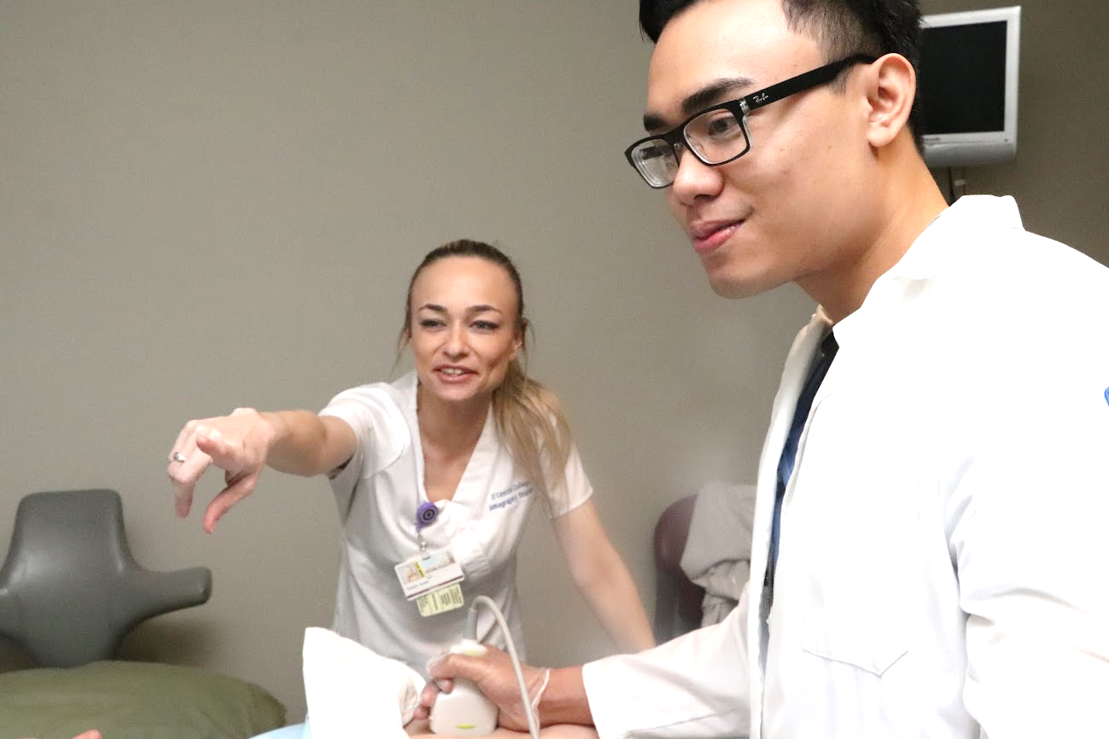
Contact Information
For general program questions and/or the application process:
Maria Johnson, BA, RDMS (AB) (OB), RVT – maria.johnson@dallascollege.edu
Heather Hobbs, RT, , RDMS (AB) (OB), RVT – heather.hobbs@dallascollege.edu
Volunteer in the scanning lab
Email: eccsono@gmail.com
Notes:
After viewing this information session and reviewing the information packet, if you have unanswered questions, feel free to contact the listed program faculty. Watch for announcements of virtual program information sessions. We recognize you are trying to chose the best career for you. We hope you explore the weblinks we recommended to learn more about sonography as well as other health care careers. Come visit us in our lab. The best way to get to know us and learn about the program is to volunteer in the sonography lab.

Slide 17
Other Program Requirements - After Acceptance
Physical Examination - to be submitted after acceptance to the program
Immunizations - to be submitted after acceptance to the program
Tuberculin skin test within the last six months (if positive, a chest x-ray is required)
Tetanus/Diphtheria/Acellular Pertussis current within 10 years
Measles/Mumps/Rubella (“MMR”) two doses of measles immunization is required either separately or in combination with MMR
Varicella (blood titer or proof of vaccine is required)
Meningitis Vaccine (Under 22 years of age – see Dallas College website for specific instructions)
Seasonal Flu Vaccine
Hepatitis B Series (three injections) – documentation is required as part of the application process.
Notes:
All of the healthcare programs at Dallas College require specific immunizations and other assessments prior to attending clinical practicum. A student interested in a career in healthcare must be prepared as some of these requirements may take up to 6 months to complete. Sample requirements include a physical exam and various vaccinations. These will be submitted if you are admitted to the program. This information can be found in the DMS Information Packet.

Slide 18
Other Program Requirements – After Acceptance
Drug Screen – to be completed after acceptance
Criminal Background Check - to be completed after acceptance
CPR – must be completed prior to clinical rotation. See information packet for which CPR course must be completed.
Medical Insurance – must carry personal health insurance prior to going to the hospital for clinical rotations.
Please note: Proof of Hepatitis B Immunization and Titer is required to be uploaded as part of the application process (pre-acceptance).
Notes:
Additional requirements include a CBC & Drug Screen and CPR certification. It is important to note that all students applying to the program will upload their proof of Hep B immunization as well as their Hep B titer.

Slide 19
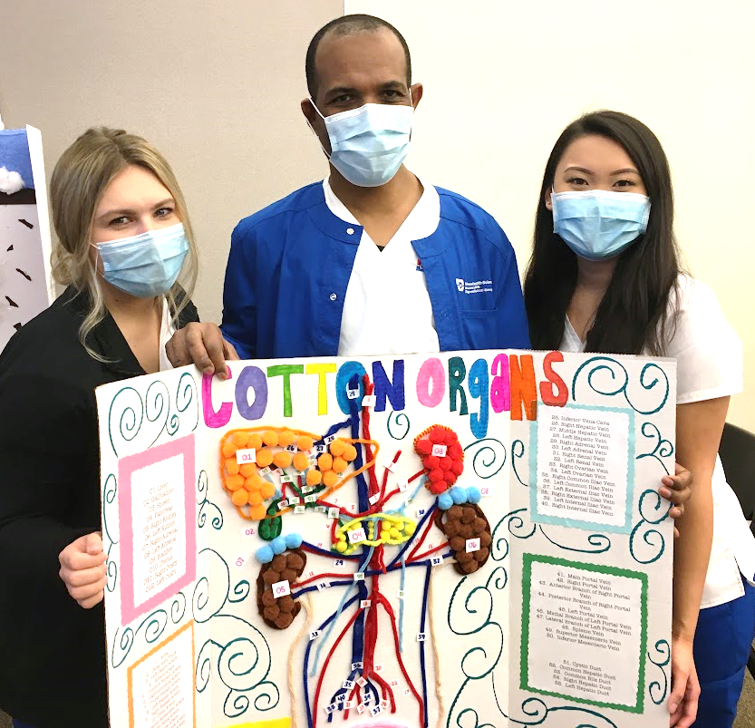
Frequently asked questions
How far will I have to drive?
Where you live contributes to the commute. Students who live in the DFW metroplex can expect to occasionally drive up to 90 minutes each way to clinical sites. Some sites do have access to public transportation (DART).
Can I plan on working while in the program?
Some students can work a few hours, however those that do, report that it impacts their grades and success in the program.
How much time should I expect to spend on Homework?
Generally, the minimum is 3 hours per/day with extra time needed for projects.
It is highly recommended that students spend 2-4 hours per week in the scanning lab to practice techniques.
How long are the breaks between semesters?
The winter break is the longest beginning mid December until mid January. The breaks between the other semester are about a week to 10 days.
Notes:
Here is a list of FAQ: How far will I have to drive. Clinical sites are as far west as Ft Worth, as far north as Denton, as far south as Waxahachie and as far east as Kauffman.
Can I work during the program – the sonography program is intensive, working can be difficult
How much time is spent on HW? – workload varies by week, in general students will spend 9-12 hours per week outside of class, reading, viewing prerecorded material and working on projects.
How long are semester breaks? – the sonography program follows the Dallas College academic calendar – the program takes a winter, spring and summer break.

Slide 20
More Frequently Asked Questions
Is the program available part-time?
Sonography students attend a over 1500 hours of clinical. These hours are not available on a part-time basis.
Is the program available online?
Although some prerequisite courses are available online, the program itself is in person. Some courses may hold classes virtually but all lab and clinical is in person.
What is the difference between this associates degree program and a bachelors degree program?
This associates degree program prepares you to function in the specialties of Abdomen, OB/Gyn, and Vascular. A bachelors degree may add a specialty in Cardiac Sonography. An associates degree is accepted by most employers.
What if I want to continue my education? Do the credits transfer?
All schools are individual is what they allow as transfer credits and it depends on the degree plan. Dallas College has at least 15 University partners that provide pathways for an easy transition. Dallas College Transfer Services
Notes:
FAQ continued: Is the program available part-time? Is the program available online? The program requires FT, in person learning. Learning sonography requires lots of hands on practice in lab and clinical. Students attend over 1500 hours of clinical practicum. Difference between Associates and Bachelors? - Most employers require a minimum of an associates degree in Sonography. A bachelors degree may be required for supervisory positions or for those interested in teaching. Dallas College has partnerships with several universities that students can transfer to and continue their education.

Slide 21
Information Session Verification
To verify you have completed this Information Session and to request access to the Secure Link to upload all application documents, please email AlliedHealthAdmissions@dcccd.edu and cc: ECC-Sonography@DallasCollege.edu.
Be sure to include “DMS Program Application” in the subject line.
Include the following information in the email:
Full Name (as listed with Dallas College)
Dallas College student ID number
Year in which you intend to apply (for example Fall 2022, Fall 2023, etc.)
You will receive a confirmation e-mail within three (3) business days.
Notes:
Please follow the instructions on this slide to notify the program that you are interested in applying. If this is the first time you have viewed this session and are just starting out - you can wait until you are closer to being ready to apply to send the email. Make sure you have viewed the most current information session prior to applying. A new information session and packet are released in September of each year. We wish you success in whatever career you decide to pursue. Thank you for your time and attention and don’t forget to visit us in our lab.

