Slide 1
Medical Front Office Assistant Program
Information Session
Thank you for your interest in the Dallas College School of Health Sciences - Medical Front Office Assistant program and welcome to our online information session!

Slide 2
Getting Started
While this information session is designed to answer many of your questions, it is meant to be reviewed alongside the information packet for the program.
Please download/print the program information packet and read it carefully to understand the program application process and other important criteria.
This information session is available for you to view as often as you like.

Slide 3
Tips for viewing this Information Session
As you view the presentation, you will find hyperlinks to various webpages; you may click on those links which will open in another window and then simply close that window to return to the information session. The session will resume at the point where you left initially.
You may pause the presentation at any time; however, remember that you are required to view the entire information session in its entirety to receive credit for your attendance and to receive the program application form.
At the end of this session, you will be directed to complete a required questionnaire which will serve as a record of your attendance.

Slide 4

Medical Front Office Assistant Program
Have you been considering a career in healthcare but would rather work in an office setting without medically related patient contact?
If so, the Medical Front Office Assistant program at Dallas College will provide you the training to jumpstart your career.

Slide 5
What is a Medical Front Office Assistant?
Medical front office assistants are healthcare professionals who work in the front or reception area of a medical office and are the first point of contact patients encounter upon entering a medical facility.
Unlike clinical medical assistants, front office assistants do not assist with medical procedures and are not directly involved with patient care.
Instead, front office assistants perform daily administrative tasks and duties that keep things running smoothly behind the scenes while providing clerical support to physicians, nurses, and other health professionals.
"Front office" skills allow you to work in a health care setting without medically related direct patient contact.

Slide 6
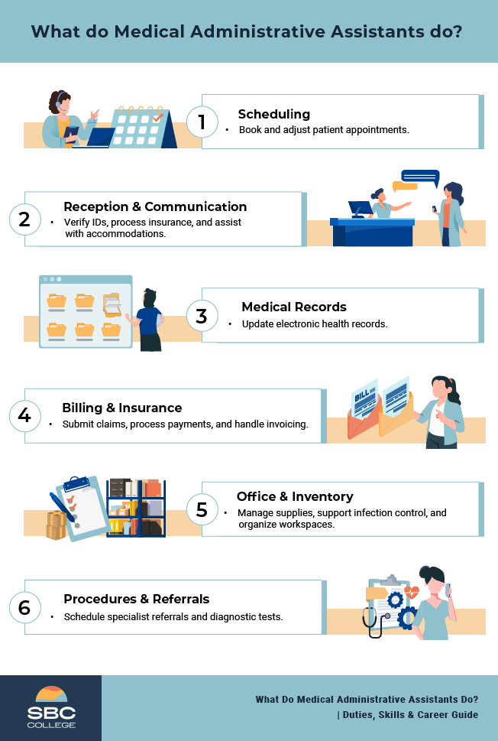
What does a Medical Front Office Assistant do?
Daily job duties of a medical front office assistant can be varied and widespread depending on the type of healthcare setting in which they are employed.

Slide 7
Some typical job duties you would be expected to perform include:
Greeting and checking in patients at the front desk
Scheduling and managing appointments
Answering and routing phone calls
Creating and maintaining patient charts
Filling out insurance forms and other kinds of paperwork
Handling correspondence
Arranging for hospital admissions or laboratory services as needed by physicians’ referrals
Processing insurance payments
Operating office software and equipment
Ordering supplies
Maintaining the reception area for the office

Slide 8
Where do Medical Front Office Assistants work?
Medical front office assistants can work in a variety of healthcare settings such as:
Physicians’ offices
Family Practices
Medical Specialty practices
Dental clinics
Vision clinics
Diagnostic Imaging centers
Outpatient care centers
Hospitals
Long term care
Assisted living facilities
Insurance companies
Agencies related to healthcare

Slide 9
What are some other job titles?
There are many different positions and titles you may apply for such as:
Medical Administrative Assistant
Medical Front Office Assistant
Medical Front Office Support
Medical Front Office Coordinator
Medical Front Desk Receptionist
Medical Receptionist
Medical Secretary
Patient Care Coordinator
Patient Services Representative
Unit Secretary
You could also replace “medical” with “clinic” or “dental” or “hospital” for any of these titles, but most will have the same job responsibilities.

Slide 10
What are some important skills?
Special skills are necessary for handling a busy and demanding medical office and ensuring a positive patient experience. Here are some of the top skills needed to succeed as a medical front office assistant:
Communication skills
Interpersonal skills
Organizational skills
Technological skills
Teamwork skills
Problem-solving skills
Professionalism
Empathy
Attention to detail
Ability to multitask
Flexibility
Adaptability

Slide 11
As a student in this program, what will you learn?
You will be trained by professional faculty in the areas of:
Medical Terminology
Medical Office Procedures
Medical Insurance Procedures
Computer Applications
Electronic Health Records Software
Medical Law and Ethics
fully preparing you with the knowledge, skills, and attitudes essential for successful employment as entry-level medical front office assistants in a variety of health care settings.
Disclaimer: The Medical Front Office Assistant program does not guarantee job placement in medical offices, hospitals, medical coding and billing offices or other relevant health care settings.

Slide 12
Why is this a good career bet?
According to the US Bureau of Labor Statistics, overall employment in healthcare occupations is projected to grow much faster than the average for all occupations from 2022 to 2032.
Health care reform and an aging population will continue to play a large role in the growth of all medical-related jobs. As a result, medical front office assistants will be in high demand with many job opportunities.
Working as a medical assistant will provide you with job stability, competitive pay and numerous benefits.
With experience, medical assistants can move into supervisory or leadership roles such as an office manager or practice manager.
With more education, they may advance into related clinical or administrative fields working as a clinical medical assistant, registered nurse, medical coder, health information technician and more.

Slide 13

Is this program and career the right fit for you?
Do you like helping people and making them feel welcome?
Are you organized, detail oriented, and good at multitasking?
Do you have a positive attitude and remain cool under pressure?
Are you a team player and work well with others?
Do you want job security along with a healthy work-life balance?
…..then a Medical Front Office Assistant career would be the right fit for you!

Slide 14
General Admission Requirements
Students who are beginning college for the first time will follow the Steps to Enrollment which will guide them through applying to the college system and enrolling in courses.
Applicants must meet all Dallas College admission requirements as outlined in the official college catalog.
Applicants to the Medical Front Office Assistant program must have earned either a high school diploma or General Education Diploma (GED).
While no TSI assessment is required, students pursuing this program must possess at least 12th grade level reading, writing and mathematics skills to demonstrate college readiness.
Consult a success coach for support and guidance from registration through graduation.

Slide 15
Program Admission Requirements
Complete an application for college admission if not already a Dallas College student.
Potential applicants must then carefully read through the program information packet and view this mandatory online information session.
After viewing the information session, applicants must complete the Required Questionnaire to record attendance and receive the program application form.
Next, request access to the Secure Link and upload the following completed application materials prior to enrolling in the MDCA 1421 Administrative Procedures course in Semester I:
  Completed and signed Medical Front Office Assistant Program Application and Statement of Students’ Responsibility forms.
  Copy of unexpired official government-issued ID (examples – driver’s license, passport, or state ID card.

Slide 16
Program Awards
The Dallas College Medical Front Office program offers the following two awards for college credit:
Medical Front Office Assistant Occupational Skills Award (Semester I)
Semester I |  | Credits
POFT 1127 | Intro to Keyboarding | 1
POFI 1301 | Computer Applications I | 3
MDCA 1313 | Medical Terminology | 3
MDCA 1421 | Administrative Procedures | 4
 | Total Credit Hours for OSA Award | 11
Medical Front Office Assistant Certificate (Semesters I, II and III)
Semester II
MDCA 1205 | Medical Law and Ethics | 2
MDCA 1443 | Medical Insurance | 4
MDCA 1391 | Special Topics in Medical Assistant | 3
Semester III
MDCA 1260 | Clinical - Medical/Clinical Assistant* | 2
 | Total Credit Hours for Certificate Program | 22
*The final externship clinical MDCA 1260 course is available only to students who have successfully completed all Semester I and II courses in the Medical Front Office Assistant Certificate program. Students must be available to work a total of 160 unpaid hours in a medical office setting.

Slide 17
Program Curriculum
The Medical Front Office Assistant program accepts two classes per year: one in the fall and one in the summer.
Restricted MDCA courses in this certificate will require official acceptance into the program and approval from Program Director, and only a Health Sciences Pathway Specialist will be able to register you in these restricted courses.
All courses in the program must be completed with a minimum grade of “C” or higher to be eligible to enroll in the next classes and to obtain the certificate.
Upon successful completion of Semester I, apply for the Medical Front Office Assistant Occupational Skills Award.
Students must complete all courses listed under Semester I prior to enrolling in Semester II courses.
Students must complete all courses in Semester I and II prior to enrolling in the final Semester III MDCA 1260 externship course.
Upon successful completion Semesters I, II and III, apply for the Medical Front Office Assistant Certificate.

Slide 18
Program Sequence
Course Sequence for Fall Entry
Fall - Semester I | Spring - Semester II | Summer - Semester III
POFT 1127 Intro to Keyboarding POFI 1301 Computer Applications I MDCA 1313 Medical Terminology MDCA 1421 Administrative Procedures | MDCA 1205 Medical Law and Ethics MDCA 1443 Medical Insurance MDCA 1391 Special Topics in Medical Assistant | MDCA 1260 Clinical - Medical/Clinical Assistant
Course Sequence for Summer Entry
Summer - Semester I | Fall - Semester II | Spring - Semester III
POFT 1127 Intro to Keyboarding POFI 1301 Computer Applications I MDCA 1313 Medical Terminology MDCA 1421 Administrative Procedures | MDCA 1205 Medical Law and Ethics MDCA 1443 Medical Insurance MDCA 1391 Special Topics in Medical Assistant | MDCA 1260 Clinical - Medical/Clinical Assistant
Note: POFT 1127, POFI 1301 and MDCA 1313 courses are offered every semester and can be completed prior to or concurrently with MDCA 1421. All other MDCA courses can only be completed in the semester in which they are scheduled as listed in the curriculum.

Slide 19
Externship Requirements
Students enrolling in the final externship clinical course must create a SurPath account no earlier than 30 days prior to the start date of this course and complete all the following:
  Submit proof of current personal health insurance to Surpath.
  Submit a professional and current resume to SurPath.
  Complete a background check and drug screening through SurPath (results must be within 30 days of the start date of course).
  Submit TB screening results to SurPath (results must be within 12 months of start date of course).
  Complete and submit any additional immunizations/documents/physical exam as required by the assigned clinical site to SurPath within specified timeframe.
Students will also be required to attend a mandatory externship orientation session on campus on a scheduled day/time in the first week of the course.

Slide 20
Estimated Expenses
The cost of the program is primarily based upon your residency status for tuition purposes.
Please see Cost and Tuition for more information and the Tuition Calculator to calculate your tuition.
The price of required learning materials including digital textbooks and online publisher content will be included with the price of tuition for the Medical Front Office Assistant program.
Tuition does not include the fees for criminal background check, drug testing, personal health insurance, TB screening, immunizations, electronic record maintenance and transportation or parking fees at the clinical sites.

Slide 21
Financial Aid and Scholarships
Determine financial needs - Apply early!
Call 972-669-6400 or email FinancialAid@DallasCollege.edu for assistance. ​
Information about financial aid can be found at this link:
  Dallas College Financial Aid
Information about scholarships can be found at this link:
  Scholarships and Other Aid

Slide 22
Before you go any further….
Refer to the Information Packet for important details and instructions regarding:
  College admission process.
  Program application materials, filing periods, and submission process.
  Program curriculum, sequence, and registration process for each semester.
  Externship requirements, SurPath registration and timeframes for required screenings, immunizations and other criteria.
  Cost estimates for the two awards offered under this program.
Note: Program guidelines are subject to change and information packets are revised each year as needed. Students are responsible for ensuring they have the latest program information packet from the Allied Health Sciences Information Packets and Sessions website.

Slide 23
Contact Information
Have a question about the Medical Front Office Assistant Program?
  Email AskSOHS@DallasCollege.edu​
  You may also send an email to Nehal Rangnekar, Professor/Program Director, at nrangnekar@DallasCollege.edu
    Please include “Medical Front Office Program” in the subject line of the email and include your full name and seven-digit student ID in the body of the email along with the specific details of what you are needing assistance with.
  Visit the Medical Front Office web page for more information.

Slide 24
Thank you for viewing this online Information Session
You will now select the button below to complete a required questionnaire over the information covered and record your attendance.
An email will be sent to you as well as our staff once you have completed the questionnaire. Please retain this email for your records and verification that you have watched the information session.
You can then expect to receive the Secure link and program application form via email in 2-3 business days during the official application filing periods.
We wish you the best!
Complete Required Questionnaire

