Slide 1

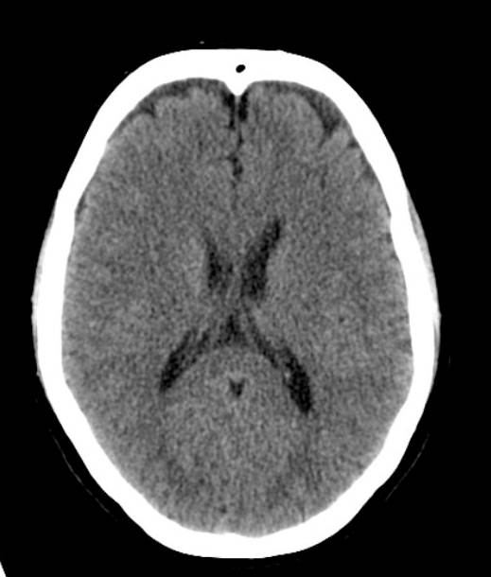
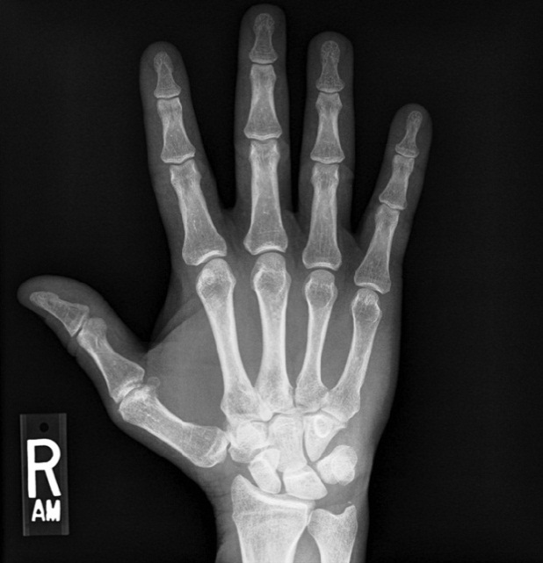
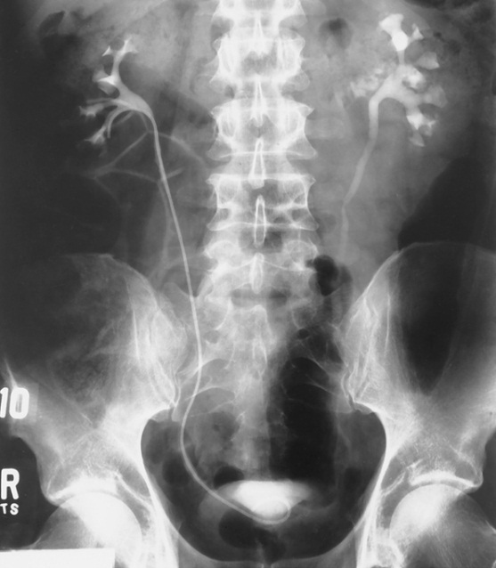

Radiologic Sciences Program
Online Orientation
Brookhaven Campus
Application Information
Radiologic Technology Program
Notes:
Welcome, everyone! Thank you for joining us for the Dallas College Radiologic Technology Program Online Orientation, presented from the Brookhaven Campus.
My name is Dr. Haynes, and I’m the Program Director for Radiologic Sciences here at Dallas College. On behalf of our entire faculty and staff, I’m excited to share this important information with you as you consider applying to one of the most rewarding and in-demand healthcare careers—becoming a registered radiologic technologist.
This orientation video is designed to give you a clear, comprehensive overview of our Radiologic Technology Program, including:
What the program entails
The time and commitment required
Prerequisites and application steps
The HESI exam requirement
Clinical expectations
And everything you need to submit a strong, complete application
Whether you’re applying for the daytime cohort, the weekend/evening cohort, or just exploring your options, this session will walk you through the key details so you can make an informed decision.
Please watch the entire presentation from start to finish because it is required before we can add you to the Radiologic Technology Applicant Portal in Microsoft TEAMS. That portal is where you’ll access testing dates, the online application, document uploads, and next steps.
So, grab a notebook, get comfortable, and let’s get started. We’re thrilled you’re here and look forward to helping you take the next step toward an exciting career in radiologic technology.

Slide 2

Radiologic Technology Program Director
Kelli Welch-Haynes, EdD, R.T.(R), (ARRT), FASRT, FAEIRS kwelchhaynes@dallascollege.edu
Radiologic Technology Program Faculty
Ashli Amos, BS, R.T.(R)(CT)(ARRT) aamos@dallascollege.edu | Leena Buckner, BS, R.T.(R)(CT)(ARRT) lbuckner@dallascollege.edu | Regina Cobb, MEd, R.T.(R)(MR) (ARRT) regina.cobb@dallascollege.edu
Shonna Cuffee, MSRS, R.T.(R) (ARRT) scuffee@dallascollege.edu | Lydia Donaldson, MBA, MHSM, R.T.(R)(CT)(ARRT) ldonaldson@dallascollege.edu | Julia Harryman, MEd, R.T.(R)(M) (ARRT) jharryman@dallascollege.edu
Shanice Henderson, MSRS, R.T.(R) (ARRT) shenderson@dallascollege.edu | Janeen Johnson, MS, R.T.(R) (ARRT) janeenjohnson@dallascollege.edu | Valerie Martin, MS, R.T.(R) (ARRT) vmartin@dallascollege.edu
Melissa Metzger, MSRS, R.T.(R) (ARRT) mmetzger@dallascollege.edu | Benjamin Plaster, MSRS, RT(R)(ARRT) Bplaster@dallascollege.edu | Melissa Metzger, MSRS, R.T.(R) (ARRT) mmetzger@dallascollege.edu
Marilyn Anderson Stewart, Med,R.T.(R)(ARRT) manderson1@dallascollege.edu | Aeisha Taylor, DHA, R.T.(R)(CT)(M) (ARRT) ataylor@dallascollege.edu | Stephanie Wells, MEd, R.T.(R)(M) (ARRT) swells@dallascollege.edu
Notes:
Next, lets Meet the dedicated team behind the Dallas College Radiologic Technology Program. As previously mentioned, I’m Dr Haynes, the Program Director. I oversee every aspect of the program—from classroom instruction and hands-on labs to clinical rotations—to make sure it all aligns with current industry standards and best practices in diagnostic imaging
Next is our outstanding faculty team, all of whom are registered radiologic technologists with real-world expertise in general radiography, advanced modalities, patient care, and beyond. Faculty members bring years of clinical practice, teaching excellence, and a genuine passion for mentoring the next generation of radiographers. They are here to guide you through challenging concepts, provide individualized support, and help you build the technical skills and professional behaviors essential for success on the ARRT certification exam and in your future career.

Slide 3

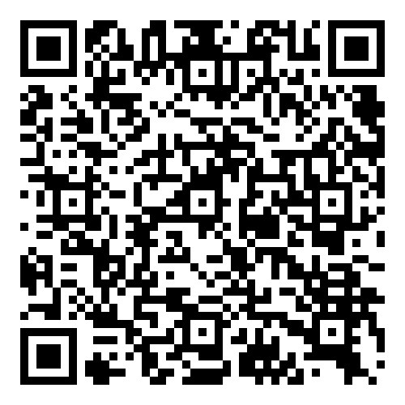
Before you go any further…
Download the Program Information Packet From the Dallas College Allied Health Information Packet Website
Notes:
Before you go any further in the application process, please pause here and download the official Radiologic Technology Program Information Packet. This is your most important resource—it contains everything you need to know in one place.
You’ll find the packet on the Dallas College Allied Health Information Packet website. It includes:
Detailed prerequisite requirements and GPA calculations
The complete application timeline and deadlines
Full selection criteria and point system
HESI exam specifics and preparation tips
Clinical requirements, immunizations, background checks, and more
Frequently asked questions and contact information
Downloading and reviewing this packet now will save you time and help you avoid common mistakes during the application. Go ahead and open the link on the slide—download it, save it to your device, and keep it handy as you move through the rest of this orientation. Once you’ve got it, you’ll be fully prepared to take the next steps with confidence.
We’ll wait right here—take a moment to grab it now!

Slide 4

Viewing Instructions:
This PowerPoint presentation is available for you to view as often as you like.
You are free to pause if you need to, but you must watch the video in its entirety to be added to the Radiologic Technology Applicant Portal in TEAMS.
Notes:
This orientation presentation is designed to help you understand everything you need to know about applying to the Dallas College Radiologic Technology Program.
The good news is that you can view this presentation as many times as you’d like—feel free to go back, pause, rewind, or take notes whenever you need a break. There’s no rush.
However, to move forward in the application process, you must watch the entire video from start to finish. Once you’ve completed it, we’ll be able to add you to the Radiologic Technology Applicant Portal in Microsoft TEAMS. That portal is where you’ll find important next steps, including HESI A2 testing dates, the online application form, document upload instructions, and more.
So, settle in, get comfortable, and let’s get started. When you reach the end, follow the instructions on the final slide to send your verification email and gain access to the portal.
We’re excited you’re considering this program—let’s begin

Slide 5
The Dallas College Radiologic Technology Program
64-credit hour curriculum
8-week semesters
Students accepted into the program will begin program classes in Spring or Summer at the Brookhaven campus.
Students accepted into the Weekend/Evening program will only begin program classes in the Spring.
Classes typically begin at 8 or 9am with labs following until 4-5pm.
Weekend/Evening classes typically begin at 8 or 9 am on Saturday with lab classes M-Th 5-9pm.
Instruction consist of lecture, lab, and clinical practicum.
Clinical practicums are held at local hospitals and clinics.
Notes:
The Dallas College Radiologic Technology Program at Brookhaven Campus is Associate of Applied Science (A.A.S.) degree with 64 credit hours—a balanced curriculum combining strong foundational knowledge and extensive hands-on clinical training to prepare you for entry-level practice as a registered radiologic technologist.
We use an accelerated 8-week semester format, so you can complete the program in about two years while staying focused and building momentum.
Accepted students begin program classes in Spring or Summer at Brookhaven, depending on the cohort. The Weekend/Evening cohort starts only in Spring for added flexibility.
In the daytime cohort, classes run 8 or 9 a.m. to 4–5 p.m. most days. The Weekend/Evening cohort starts at 8 or 9 a.m. on Saturday, with lab sessions Monday–Thursday evenings 5–9 p.m.—perfect for balancing work or family.
Instruction includes lecture, hands-on labs, and clinical practicum at local hospitals and clinics. You’ll perform real diagnostic imaging under supervision, apply radiation safety, and build patient care skills.
Clinical rotations are the heart of the program—they build the confidence and competence needed to pass the ARRT exam and launch your career.
This is an intensive but rewarding path that demands dedication and time management. It opens doors to a stable, meaningful career with strong job prospects.
We’ll cover time commitment and financial planning in the next slides to help you prepare realistically.
For now, know our program is designed to produce safe, skilled, compassionate technologists ready to make a difference from day one

Slide 6
Things to consider before applying to the program for the DAYTIME cohort
This program requires a significant time commitment
Semesters 1 thru 3:
3-4 days/week from 8a – 5p
Each long semester consist of 2, 8-week sessions and an 8-week summer session. Plan to attend open lab when offered to extend upon what you’ve learned during the week.
Semesters 4 thru 8:
On campus 8am – 4pm on Monday.
At hospital 8-hour shifts, 4 days per week for a total of 32 clinical hours.
Students will participate ½ year on days, ½ year on evenings. Day shift hours range from 7:00am – 6pm. Evening hours can vary from 11:00am – 11pm.
Notes:
This program requires a significant time commitment. For Semesters 1 through 3 in the daytime cohort: expect 3–4 days per week from 8 a.m. to 5 p.m. Each long semester includes two 8-week sessions plus an 8-week summer session. Plan to attend open lab sessions when offered to reinforce weekly learning.
For Semesters 4 through 8: on-campus Mondays from 8 a.m. to 4 p.m., plus 8-hour clinical shifts 4 days per week (total 32 clinical hours). Students rotate half the year on days (7 a.m.–6 p.m.) and half on evenings (hours varying from 11 a.m.–11 p.m.)

Slide 7
Things to consider before applying to the program for the WEEKEND/EVENING cohort
This program requires a significant time commitment
Semester 1 thru 3:
3-4 days/week from 5p – 9p
Each long semester consist of 2, 8-week sessions and an 8-week summer session. Plan to attend open lab when offered to extend upon what you’ve learned during the week.
Semesters 4 thru 8:
On campus 5pm– 9pm some evenings during the week.
At hospital 10-hour shifts, Saturday – Monday for a total of 30 clinical hours.
Weekend shift hours range from 7:00am to 11pm.
Notes:
For the Weekend/Evening cohort, Semesters 1 through 3 involve 3–4 days per week from 5 p.m. to 9 p.m., with the same 8-week structure and open lab recommendations.
Semesters 4 through 8 include some evening on-campus time (5–9 p.m.) and 10-hour clinical shifts Saturday through Monday (total 30 clinical hours), with weekend hours ranging from 7 a.m. to 11 p.m.

Slide 8
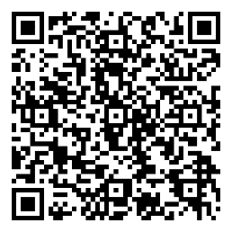
Financial Impact
Students find it difficult to work more than a few hours a week while in the program.
it is imperative that applicants prepare a budget and save money to help lessen the financial strain.
The college offers several resources that can be found on the Dallas College Financial Aid website.
Notes:
Now, let’s talk openly about the financial side of the Radiologic Technology Program—one of the most important things to plan for before starting.
Students consistently find it very difficult to work more than a few hours per week—often no more than 10–15 hours—because the schedule is intensive: full days of lecture, lab, and clinical rotations (up to 32 hours/week in later semesters), plus studying, open labs, and exam prep. Many describe it as a full-time job, and adding heavy work often leads to burnout, lower grades, or challenges meeting clinical requirements.
For that reason, it’s essential to prepare a budget and save money in advance to ease financial strain. Treat the next two years as a focused investment in your career—build a cushion now so you can commit fully without juggling multiple jobs.
Dallas College offers great support:
Federal and state financial aid (grants, loans, work-study)
Health sciences scholarships
Emergency funds and payment plans
Advising to maximize eligibility
Visit the Dallas College Financial Aid website for details, calculators, and steps. Meet with an advisor early—many students are surprised by the help available.
Planning ahead financially lets you focus on learning, clinical skills, and ARRT exam prep without constant worry. You’re making a big commitment—let’s set you up to ensure your success

Slide 9
What’s it like to be a Radiologic Technologist?
Radiologic technologists perform diagnostic imaging exams (x-rays) on patients and are important members of the patient care team.
We work in hospitals, clinics, imaging centers, and can also be employed as application specialists or sales reps.
Notes:
Let’s talk about what it’s really like to be a radiologic technologist—or as we often call ourselves, a Rad Tech.
At its core, we perform diagnostic imaging exams—primarily x-rays—but we’re so much more than that. Rad Techs are essential members of the patient care team, working side-by-side with physicians, nurses, and other healthcare professionals to help diagnose and treat medical conditions every single day.
You’ll find us in a wide range of settings: busy hospital emergency departments, outpatient clinics, dedicated imaging centers, mobile units, even surgical suites for intraoperative imaging. Some experienced technologists move into specialized roles as application specialists for equipment manufacturers, sales representatives, educators, or quality assurance coordinators—there’s real variety and room to grow.

Slide 10
As a Radiologic Technologist, you will be expected to:
Adjust technical factors on imaging equipment | Precisely following physician’s orders.
Protect the patient from excess exposure | Prepare patients for exams.
Position the patient and equipment. | Work with radiologists.
Operate equipment and computer systems. Evaluate images to ensure optimal quality. | Maintain detailed patient records Work well with members of a team
Notes:
Day-to-day as a Rad Tech, your work is hands-on and truly impactful. You’ll adjust imaging equipment for safety and performance, protect patients and yourself from excess radiation, position patients carefully for the best diagnostic images, operate x-ray systems and software, evaluate images on the spot for quality, follow physician orders precisely, prepare and reassure anxious patients, collaborate with radiologists and the team, maintain accurate records, and thrive in a fast-paced environment that demands communication, empathy, and quick thinking.
You’re often the first friendly face a patient sees in a stressful moment—helping catch fractures, detect issues early, and guide critical care. It’s a career blending technology, science, and human connection, with variety every day and real satisfaction knowing your images influence patient outcomes.
It’s demanding, but incredibly rewarding. If this excites you, you’re in the right place. The Dallas College Radiologic Technology Program is designed to prepare you for exactly this kind of meaningful role. Let’s keep going!"

Slide 11
Physical Requirements
Manual dexterity to:
Physical ability to:
Use sterile technique
Examples: to insert catheters or prepare and administer medications
Manipulate and assemble equipment for use.
Stoop, bend, and stand for prolonged periods of time
Perform cardiopulmonary resuscitation (CPR)
Lift patients and equipment
Push equipment from room to room
Maneuver in limited spaces
Move quickly in emergency situations
Visual acuity to: (with corrective lenses if needed)
View images (x-rays) to determine quality and identify anatomy in low light environments
Observe absence of respiratory movements in patients
Notes:
Physical demands include manual dexterity for sterile technique (e.g., inserting catheters or preparing medications) and assembling equipment; visual acuity (with corrective lenses if needed) to view radiographs in low light and observe patient conditions; and the ability to stoop, bend, stand for long periods, perform CPR, lift patients/equipment, push equipment, maneuver in tight spaces, and move quickly in emergencies

Slide 12


Communication Requirements
Communicate effectively in written and verbal form by:
Speaking clearly and succinctly when:
Explaining treatment procedures
Describing patient conditions
Implementing health techniques
Functioning safely under stressful conditions with the ability to:
Adapting to the ever-changing environment inherent in clinical situations involving patient care
Utilizing computer skills to:
Use a variety of software programs and the internet for research and course projects.
Notes:
You must communicate effectively in written and verbal form—speaking clearly when explaining procedures, describing conditions, or implementing techniques; function safely under stress in changing clinical environments; and use computer skills for software, internet research, and projects."

Slide 13

The Job Outlook for Radiologic Technologists
Employment of radiologic technologists is expected to grow faster than average for all occupations, increasing 6% from 2022-2032.
The median pay in 2023 for R.T.’s in the U.S was $73,410/year ($35.30/hr)
Requires an Associate’s Degree
More education = more opportunities for growth!
Those with multi-modality training may have greater employment opportunities.
A healthcare career provides opportunities to work a variety of shifts, some of which pay a shift differential.
According to the U.S. Bureau of Labor Statistics Information: Radiologic Technologist
Notes:
Employment for radiologic technologists is projected to grow 6% from 2022–2032 (faster than average). Median pay in 2023 was $73,410 per year ($35.30/hour). An associate degree is required—more education opens greater opportunities. Multi-modality training improves job prospects. Healthcare careers offer various shifts, some with differentials. (Source: U.S. Bureau of Labor Statistics)"

Slide 14
Program Acceptance
Upload Supporting Documents
Complete Radiography Program Application
The Application Process
Complete Prerequisite Courses
Take and pass the HESI A2 exam at Brookhaven Campus
Watch online orientation video
Review Program Information Packet
Apply to Dallas College
Notes:
Steps: Apply to Dallas College → Review the Program Information Packet → Watch this online orientation video → Take and pass the HESI A2 at Brookhaven Campus (on assigned dates) → Complete prerequisite courses → Submit the online Radiography Program Application → Upload supporting documents."

Slide 15
Prerequisite Courses
Dallas College Course
ENGL 1301 Composition I
MATH 1314 College Algebra
BIOL 2401 Anatomy & Physiology I*#
RADR 1201 Introduction to Radiography*
RADR 2209 Radiographic Imaging Equipment*
* These courses must be completed within 5 years of the application semester. Points for RADR 1201 and RADR 2209 will be assessed on first or second attempts only. The grade on the most recent of the two attempts will be used to assign application points. For example: RADR 1201 was taken in the Summer of 2023, the Fall of 2023, and the Spring of 2024. The Fall 2023 grade will be used for application points.
# You must earn a B or higher in this BIOL 2401.
*Science and RADR courses must be completed less than 5 years prior to program application.
Applicants must earn a minimum cumulative grade point average of 3.0 or higher for these prerequisite courses (#you must have a “B” or higher in BIOL 2401)
Major Change
Program applicants must complete the five program prerequisite courses by the application deadline (April 1 for summer cohort or November 1 for spring and weekend/evening cohorts)
Notes:
Prerequisites (minimum 3.0 cumulative GPA; B or higher in BIOL 2401): ENGL 1301 Composition I, MATH 1314 College Algebra, BIOL 2401 Anatomy & Physiology I, RADR 1201 Introduction to Radiography (within 5 years), RADR 2209 Radiographic Imaging Equipment (within 5 years). Points for RADR courses based on first or second attempt (most recent grade used). Complete all by deadline: April 1 (Summer cohort) or November 1 (Spring/Weekend-Evening)."

Slide 16

THE HESI A2 Exam is required for the application
HESI
A scaled score of 75 or above on the HESI exam is required.
A minimum grade of 70 must be earned in each category.
The HESI test MUST be taken with the Radiologic Technology Faculty
on the assigned testing day at the Brookhaven Campus.
Testing dates will be listed in the Applicant Portal in TEAMS.
No other scores will be accepted.
You must take the following sections of the HESI Test. You will be given 4 hours to complete all sections.
Reading Comprehension | Grammar
Vocabulary and General Knowledge | Math
Anatomy & Physiology | Personality/Learning Style (not scored or used for admission)
Notes:
HESI stands for Health Education Systems Incorporated.
Required scaled score: 75+ overall, minimum 70 in each category. Sections: Reading Comprehension, Grammar, Vocabulary/General Knowledge, Math, Anatomy & Physiology, Personality/Learning Style (not scored). Must take with Radiologic Technology faculty at Brookhaven on assigned dates (listed in TEAMS portal). No other scores accepted. Prep: Use HESI Admission Assessment Exam Review book

Slide 17

Preparing for the HESI Exam
A HESI Admission Assessment Exam Review is available at the circulation desk in the library. It is for reference use only and cannot be removed from the library.
You can purchase a HESI Admission Assessment Exam Review for personal use from any bookseller.
If you’re interested, the College also offers a HESI prep-class (NURZ-1004) through the Continuing Education Department.
How to Register for the Course:
Online: https://www.dallascollege.edu/admissions/registration/pages/ce-registration.aspx
Additional Help: https://www.dallascollege.edu/contact/pages/default.aspx
ISBN: 9780443114090
Copyright: 2025
Publication Date: 06-18-2024
Page Count: 192
Imprint: Elsevier
List Price: $45.99
Notes:
Now let’s talk about preparing for the HESI Admission Assessment Exam, which is a required step for program eligibility.
To help you get ready, Dallas College provides excellent resources. First, a copy of the HESI Admission Assessment Exam Review book is available at the circulation desk in the Brookhaven Campus library. This is a reference copy only—you can use it in the library to study, but it cannot be checked out or taken home.
If you’d like your own copy to study at your convenience, you can purchase the HESI Admission Assessment Exam Review from any major bookseller—online or in-store. The current edition is ISBN 9780323582261 (note: a newer edition may be released soon, so check for the most up-to-date version when buying).
Additionally, Dallas College offers a dedicated HESI prep class through our Continuing Education Department—course number NURZ-1004. This structured class is designed to review the key sections of the HESI (Reading Comprehension, Grammar, Vocabulary, Math, Anatomy & Physiology, and more) and help build your confidence before test day.
To register for NURZ-1004, visit the Continuing Education registration page online at the link shown here: https://www.dallascollege.edu/admissions/registration/pages/ce-registration.aspx. If you need any help with registration or have questions, you can find support at https://www.dallascollege.edu/contact/pages/default.aspx or reach out to the Continuing Education office directly.
Taking advantage of these resources—whether it’s the library reference book, purchasing your own copy, or enrolling in the prep class—can make a big difference in your performance. The HESI is challenging, but with focused preparation, most applicants achieve the required 75+ overall score.
We recommend starting your prep early so you feel fully ready on test day. You’ll find your assigned testing dates and enrollment instructions once you’re added to the TEAMS Applicant Portal after completing this orientation."

Slide 18
Complete the Online Application Form
The online application will be available on the first day of the semester in which you are applying.
To complete the online application form, you will need the following:
Demographic Information
name, address, student ID, email, phone number, etc.
Names of all colleges attended.
Course grades, college, semester completed and course title if different – for all prerequisites and other general education courses required for the degree.
Degree(s) conferred
The online application form must be filled out and submitted prior to April 1 for Summer cohorts and November 1 for Spring & Weekend/Evening cohorts.
Notes:
Application opens first day of Fall/Spring semester. Submit by November 1 (Fall apps, start January) or April 1 (Spring apps, start June). Include demographics, colleges attended, grades, degrees. Upload supporting documents by deadlines (see packet/portal)

Slide 19
Upload Supporting Documents
Review the information packet for the list of supporting documents.
Descriptions of each document are outlined in the information packet and in the TEAMS applicant portal.
If you plan to substitute any courses toward the AAS in Radiologic Science degree plan, you should contact a SOHS Pathway Specialist at asksohs@dallascollege.edu
All supporting documents are due by April 1 for Summer cohort and November 1 for Spring & Weekend/Evening cohorts.
Notes:
Once you’ve completed your prerequisites and passed the HESI A2, the next critical step is uploading all required supporting documents.
First, review the official Radiologic Technology Program Information Packet for the complete list of supporting documents needed. This packet is your go-to guide—it outlines exactly what to submit and why each item is important.
Detailed descriptions of each document, including format requirements and examples, are also available in the TEAMS Applicant Portal once you’re enrolled. So after you verify watching this orientation by emailing bhcRadTech@dcccd.edu, you’ll get access to the portal and can double-check everything there.
If you’re planning to substitute any courses toward the Associate of Applied Science in Radiologic Sciences degree plan—perhaps from prior college coursework—please contact a School of Health Sciences Pathway Specialist right away at asksohs@dallascollege.edu. They can evaluate your transcripts and advise on any possible substitutions before you submit your application.
Important deadline reminder: All supporting documents must be uploaded by April 1 for the Summer cohort or November 1 for the Spring and Weekend/Evening cohorts. Missing this deadline will mean your application is incomplete and cannot be considered, so plan ahead and submit everything early if possible.
Take your time to gather clean, legible copies of transcripts, HESI score report, any required certifications, and other items listed. The portal makes uploading straightforward, and the team reviews everything carefully to ensure fairness in the selection process.
You’re getting close—stay organized, follow the packet closely, and reach out if you have any questions. We’re here to help you submit a strong, complete application!

Slide 20

Application Filing Period
Official application filing period for the program admission begins the FIRST day of the Fall Semester and the FIRST day of the Spring Semester.
Deadline to complete the online application form and all prerequisites is:
Nov. 1st for the Fall application period (start date of January) and
April 1st for the Spring application period (start date of June).
Current semester grades from other colleges will need to be submitted directly to the program office if they impact your application. NOTE: If you are taking a course that ends after the application deadline, you will not be able to apply that course toward your application.
Notes:
Let’s go over the application filing period so you know exactly when and how to submit everything.
The official application window for the Radiologic Technology Program opens on the first day of the Fall Semester for the Spring cohort start (January) and on the first day of the Spring Semester for the Summer cohort start (June).
Your deadlines are firm:
For the Fall application period (classes starting in January), you must complete the online application form and all prerequisites by November 1.
For the Spring application period (classes starting in June), the deadline is April 1.
Supporting documents—such as transcripts, HESI scores, and any other required items—must also be uploaded by these same dates: November 1 for Fall applications and April 1 for Spring applications. Late submissions cannot be accepted, so plan to finish everything well in advance.
One important note: If you’re currently taking a prerequisite course that ends after the application deadline, that course cannot be used toward your application for that cycle. You’ll need to wait until the next application period when the grade is official.
Also, if you have grades from another college that are posted in the current semester and could impact your prerequisite GPA or points, submit those transcripts directly to the program office as soon as they’re available—don’t wait for them to transfer automatically.
Missing a deadline or an incomplete application means you won’t be considered, so mark these dates on your calendar and double-check your progress in the TEAMS Applicant Portal. We want to see your best, complete application—timing is everything!
If any of this feels unclear, refer back to the Program Information Packet or reach out to one of our contacts listed later in the presentation. You’ve got this—stay organized and submit early!

Slide 21
Selection Process
Please refer to the Dallas College Radiologic Science Program Information Packet for Applicant Selection Criteria
Notes:
The selection process for the Radiologic Technology Program is competitive and based on a clear, transparent point system designed to identify the most prepared and committed applicants.
To keep things straightforward, we do not cover the full details of the selection criteria here in the orientation video. Instead, please refer directly to the Dallas College Radiologic Science Program Information Packet—your complete guide to everything in the admissions process.
In the packet, you’ll find the exact applicant selection criteria, We use this structured approach to maintain fairness, meet JRCERT accreditation standards, and select students who are most likely to succeed in our rigorous program and become excellent radiologic technologists.

Slide 22
Other Program Requirements - AFTER Acceptance
Physical Examination - to be completed AFTER acceptance to the program
Immunizations - to be completed AFTER acceptance to the program
Tuberculin skin test within the last six months (if positive, a chest x-ray is required)
Tetanus/Diphtheria/Acellular Pertussis current within 10 years
Measles/Mumps/Rubella (“MMR”) two doses of measles immunization is required either separately or in combination with MMR
Varicella (blood titer or proof of vaccine is required)
Meningitis Vaccine (Under 22 years of age – see Dallas College website for specific instructions)
Seasonal Flu Vaccine
Hepatitis B Series (three injections)
Notes:
After provisional acceptance: Physical exam, immunizations (TB test, Tdap, MMR, Varicella, Meningitis if under 22, Flu, Hep B series), drug screen, criminal background check (check ARRT/TMB ethics pre-approval if needed), CPR certification before clinicals, personal health insurance.

Slide 23
Other Program Requirements – AFTER Acceptance
Drug Screen – to be completed AFTER acceptance
Criminal Background Check - to be completed AFTER acceptance
For additional information on criminal history and ARRT ethics requirements go to www.arrt.org for ARRT Ethics Pre-Approval
For additional information on criminal history and TMB ethics requirements go to www.tmb.state.tx.us for the Texas Medical Board – Criminal History Evaluation Letter
CPR – must be completed prior to clinical rotation. See information packet for which CPR course must be completed.
Medical Insurance – must carry personal health insurance prior to going to the hospital for clinical rotations.

Slide 24
Contact Information
For general program questions and/or the application process:
Kyle Kolbye, Admissions Coordinator– kkolbye@dallascollege.edu
Kelli Welch Haynes, EdD, R.T.(R),FASRT, FAEIRS, Program Director – kwelchhaynes@dallascollege.edu
Leena Buckner, BS, R.T.(R)(CT)(ARRT) Weekend/Evening Program Faculty- lbuckner@dallascollege.edu
For assistance with course substitutions:
School of health sciences: asksohs@alliedhealth.edu
Notes:
For questions: Kyle Kolbye (kkolbye@dallascollege.edu), Kelli Welch Haynes (kwelchhaynes@dallascollege.edu), Ashli Amos (aamos@dallascollege.edu), Leena Buckner (lbuckner@dallascollege.edu). Course substitutions: asksohs@alliedhealth.edu.

Slide 25



Information Session Verification
After sending this email, you will be enrolled in the TEAMS Applicant Portal
HESI dates and enrollment information can be found in the portal
You have reached the end of the information session. If you plan to apply this application cycle, please send an email to bhcRadTech@dcccd.edu indicating your interest in applying to the program
Include the following in the email:
Full Name (as listed with Dallas College)
Dallas College student ID number
Application semester/year
You will receive a confirmation e-mail within 3-business days that you’ve been added to the Portal. You will then have access to the Online Application Form, HESI enrollment and upload area for Supporting Documents
Notes:
You've reached the end. If planning to apply this semester, email bhcRadTech@dcccd.edu with your full name (as in Dallas College records), student ID, and application semester/year. You'll be added to the TEAMS Applicant Portal within 3 business days, where you'll find HESI dates, application form, and upload area.“ If you're an applicant needing to verify watching this video, follow the instructions in the information packet and send the email to get portal access

